Slide 1
My Dad’s Trash Compactor Invention
David M. Boje

Slide 2
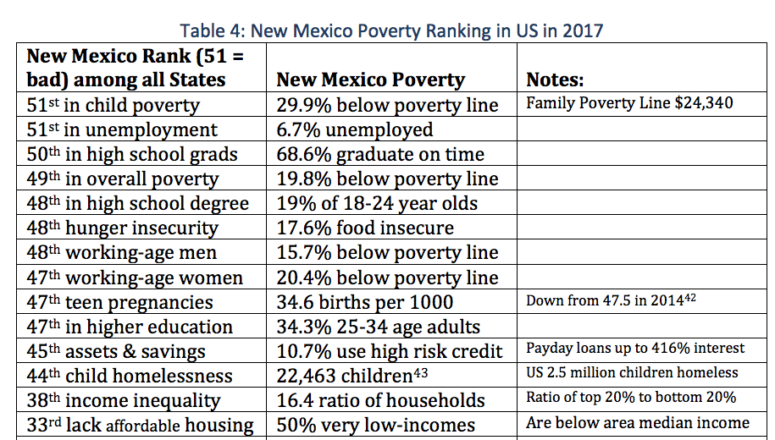
Notes:
https://www.huffingtonpost.com/rep-bernie-sanders/what-can-we-learn-from-de_b_3339736.html?utm_hp_ref=tw
Denmark is a small, homogenous nation of about 5.5 million people. The United States is a melting pot of more than 315 million people. No question about it, Denmark and the United States are very different countries. Nonetheless, are there lessons that we can learn from Denmark?
In Denmark, social policy in areas like health care, child care, education and protecting the unemployed are part of a “solidarity system” that makes sure that almost no one falls into economic despair. Danes pay very high taxes, but in return enjoy a quality of life that many Americans would find hard to believe.
Health care in Denmark is universal, free of charge and high quality. Everybody is covered as a right of citizenship. The Danish health care system is popular, with patient satisfaction much higher than in our country. In Denmark, every citizen can choose a doctor in their area. Prescription drugs are inexpensive and free for those under 18 years of age. Interestingly, despite their universal coverage, the Danish health care system is far more cost-effective than ours.
In Denmark, more than 75 percent of the people are members of trade unions. In America today, as a result of the political and economic power of corporate America and the billionaire class, we are seeing a sustained and brutal attack against the economic well-being of the American worker.

Slide 3
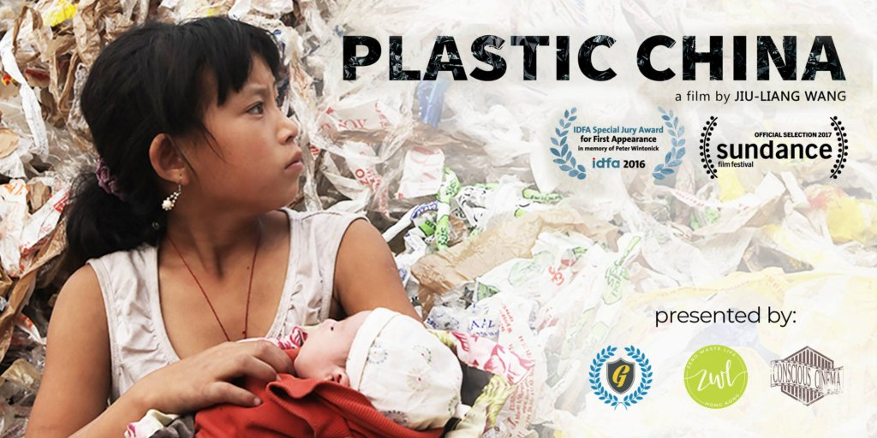
Plastic CHINA film banned by China
See short version https://www.youtube.com/watch?v=mleQVO1Vd1I

Slide 4
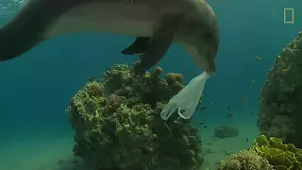
PLASTIC PLANET * PLASTIC NMSU
Plastic pollution poses one of the biggest known threats to the ocean, influencing all ecosystems from beautiful coral reefs to abyssal trenches, eventually accumulating in our own food & in our body. https://www.youtube.com/watch?v=HQTUWK7CM-Y

Slide 5
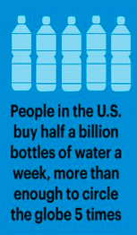
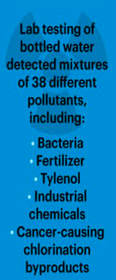
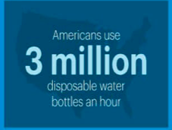

Slide 6
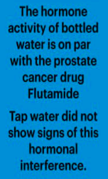
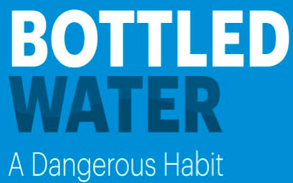
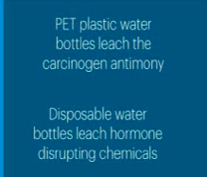

Slide 7
Why does NMSU contract with PEPSI and AQUAFINA?
Microplastic particles leach in to Pepsi & Aquafina bottles, and at higher rates in hotter desert climates of New Mexico. Therefore Dear Aggies, it is healthier to use Tap Water, or better, to use the Filtration Water in reusable containers. These are the findings of David Boje and do not represent the University is a Business strategy of New Mexico State University

Slide 9
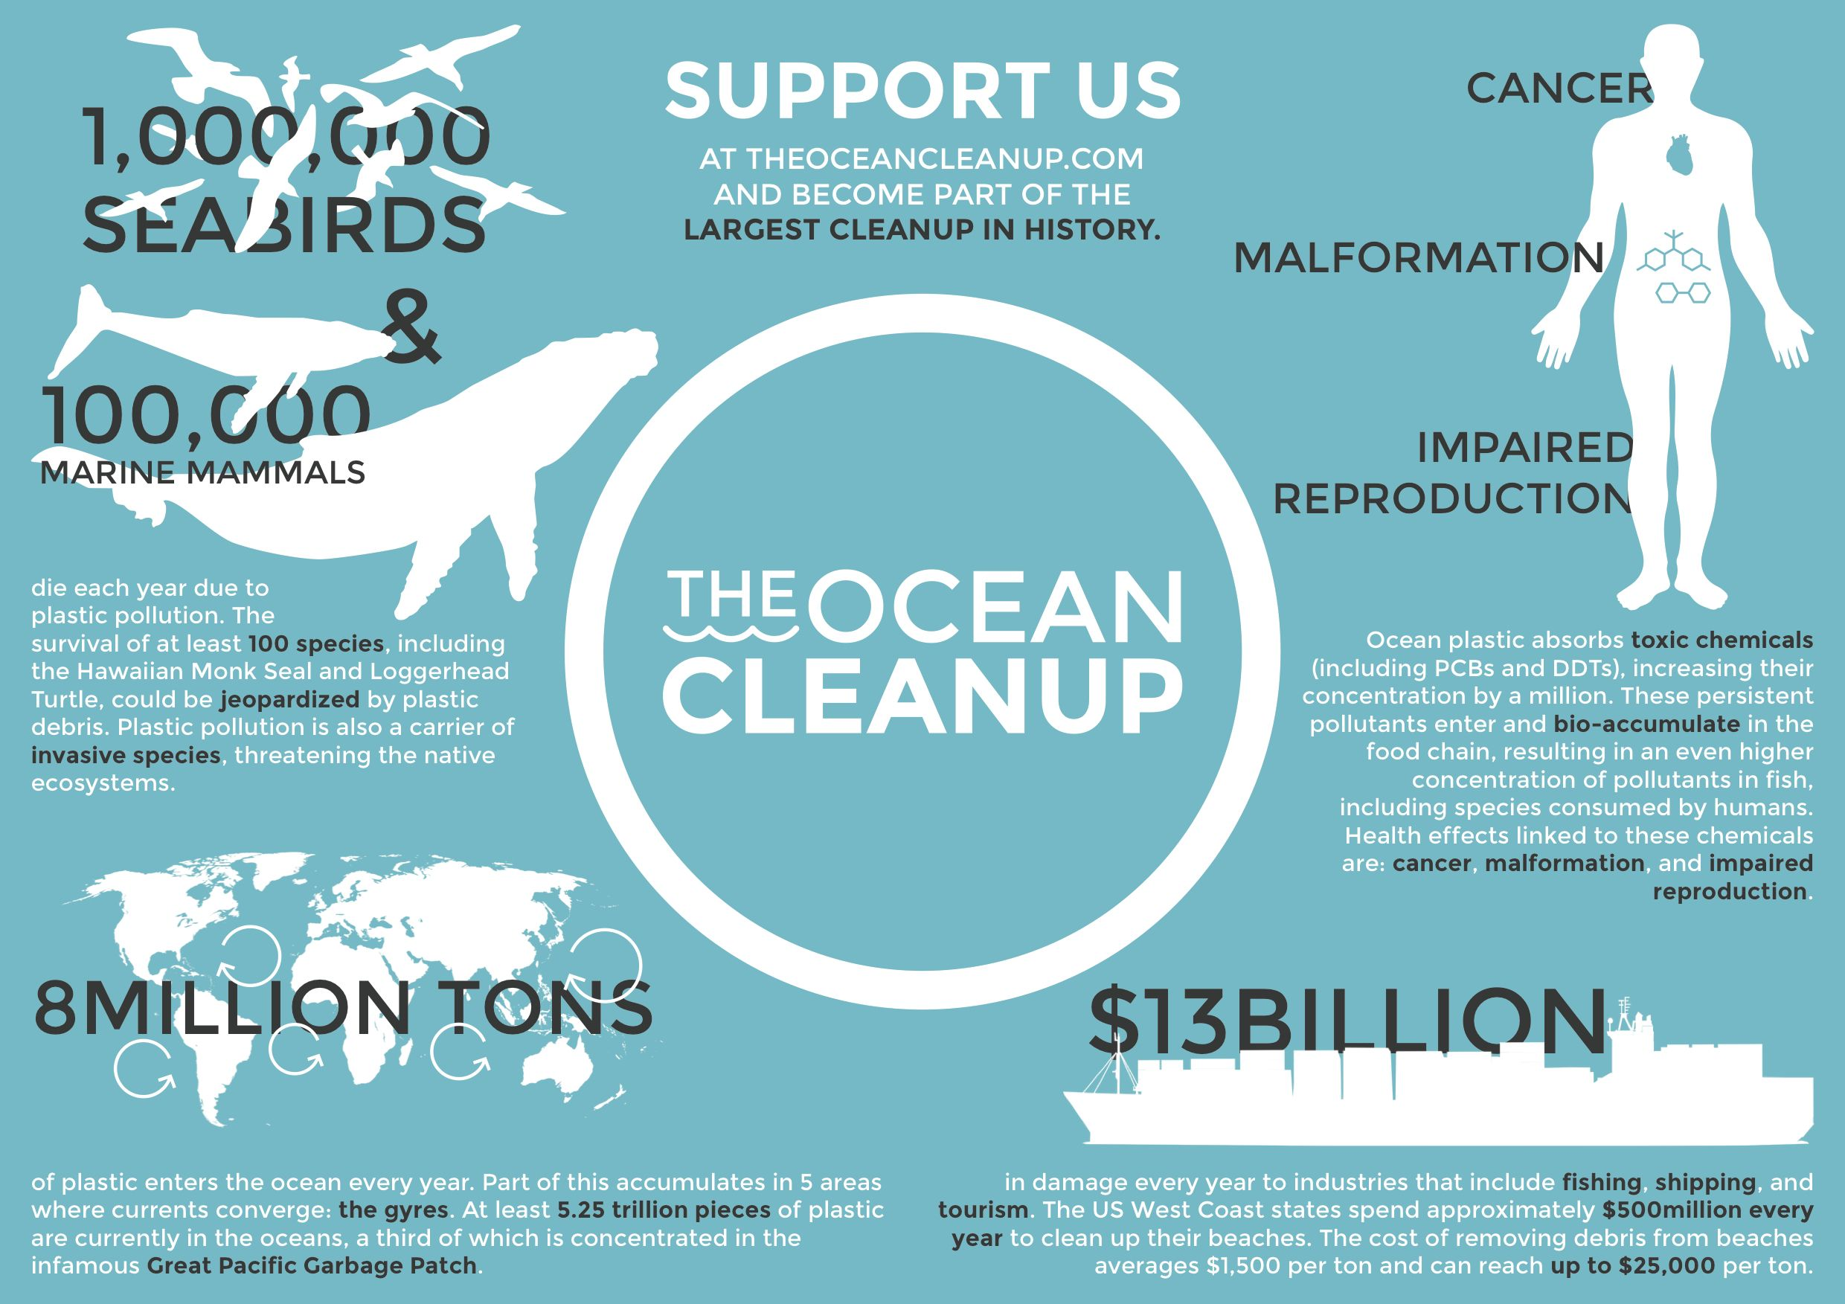

Slide 10
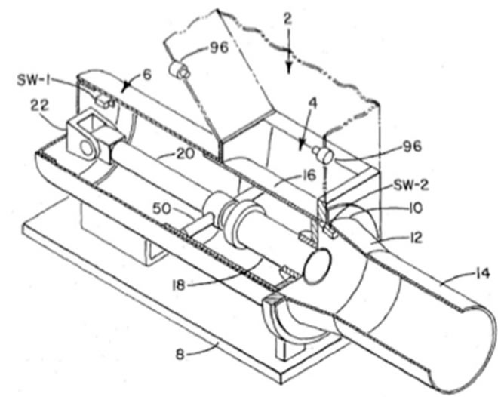

Slide 12
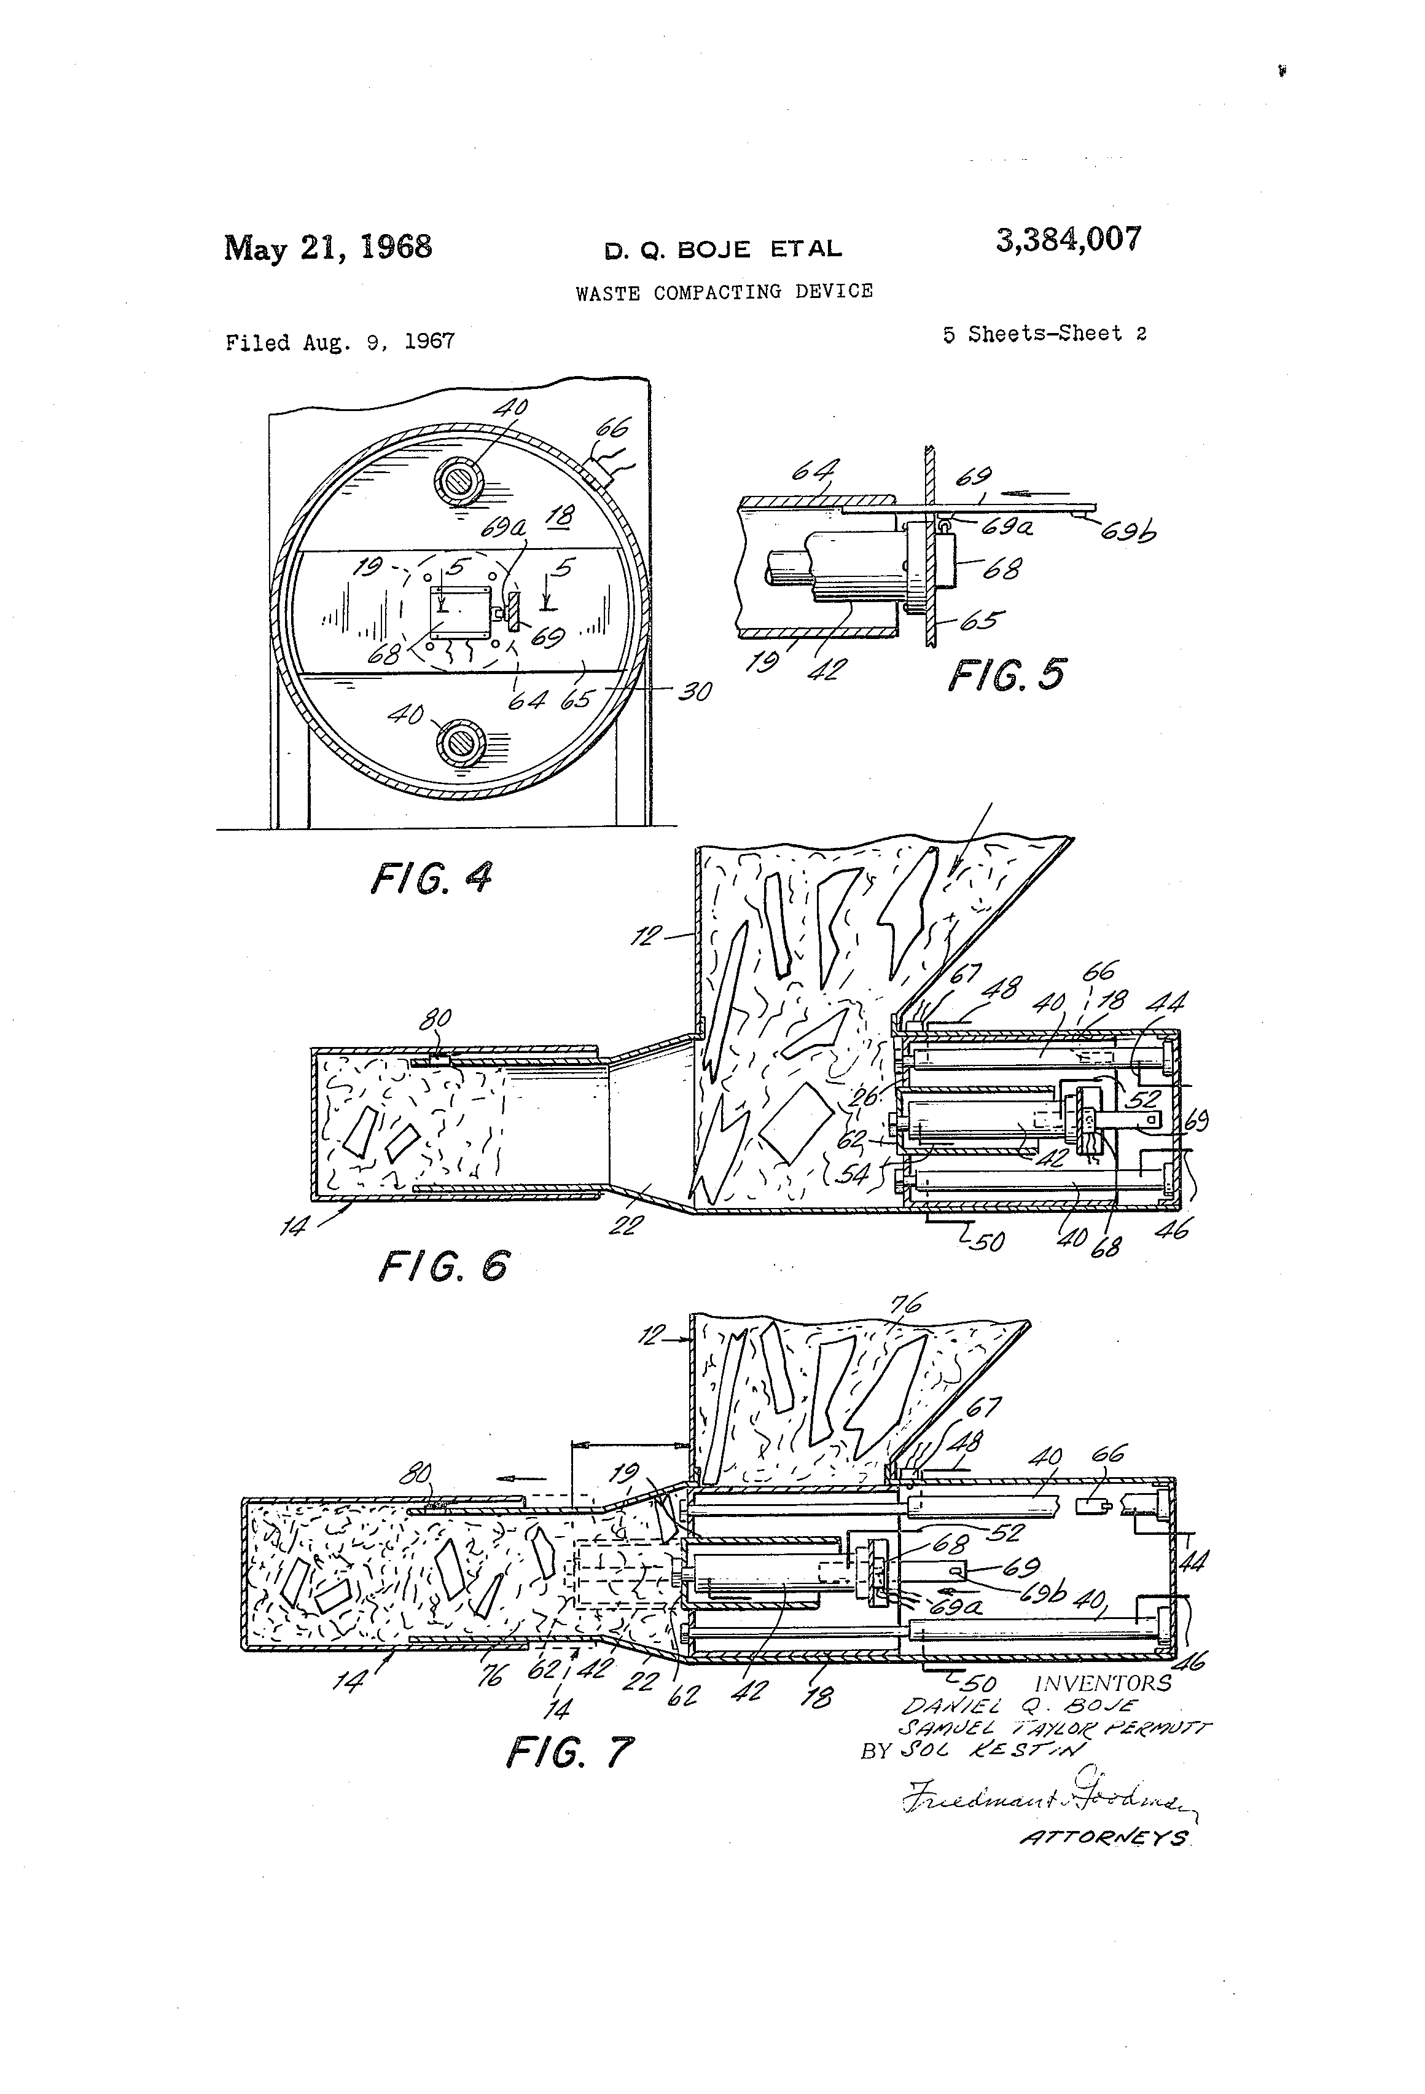
Daniel Boje Trash Compactor
https://patents.google.com/patent/US3384007
United States Patent O 3,384,007 WASTE COMPACTING DEVICE
https://business.nmsu.edu/~dboje/655/New_Materialisms_and_Systemicity.html

Slide 13
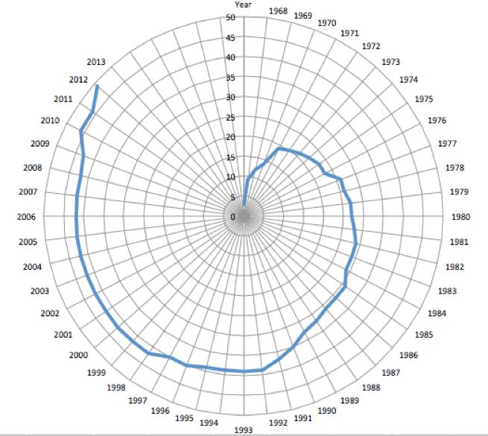
https://business.nmsu.edu/~dboje/690/What_is_Fractal_Storytelling.htm

Slide 14
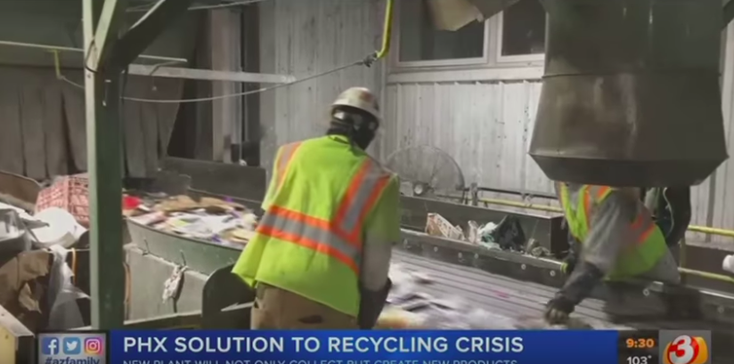
Phoenix Solution to the Recycling Crisis
1:18
VIDEO: Phoenix solution to recycling crisis in development
https://www.youtube.com/watch?v=Kqr1wKSGOp4

Slide 15
Technology to Clean the Ocean of Plastic
Plastic is poisoning the food chain, that includes what we eat
Boyan Slat: How we will rid the oceans of plastic (May 2017) – 50% cleanup of plastic patch within 5 years
YouTube https://www.youtube.com/watch?v=du5d5PUrH0I
Another YouTue of Boyan Slat
https://www.youtube.com/watch?v=ROW9F-c0kIQ

Slide 16
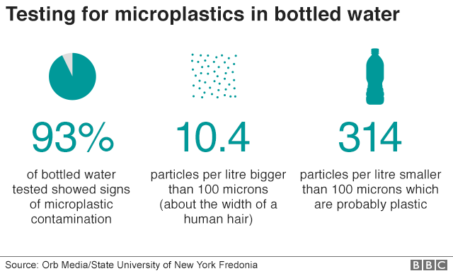
Why does NMSU sell Pepsi & Aquafina Single Use Plastic Bottles to AGGIES?

Slide 17
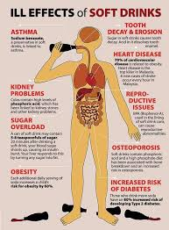
Pepsi is NOT Healthy
PEPSI and COKE health effects https://www.youtube.com/watch?v=Fz-A1uuA6QE
https://www.youtube.com/watch?v=7F3FVyOnXR8 YouTube Boycott by corporations worried about content critical of Pepsi, etc.

Slide 18
Pepsi sold at NMSU will kill the body slowly
https://www.youtube.com/watch?v=xFjjzuAjB0U
Contains 41 grams of sugar, and your blood sugur spikes, and liver bursting with insulin, blood pressure rises, etc.
What happens to your body when you drink PEPSI/COKE?
https://www.youtube.com/watch?v=gVyZiYbsvLY
EVERYTHIING WRONG WITH PEPSI https://www.youtube.com/watch?v=izocIxxp7QQ

Slide 19
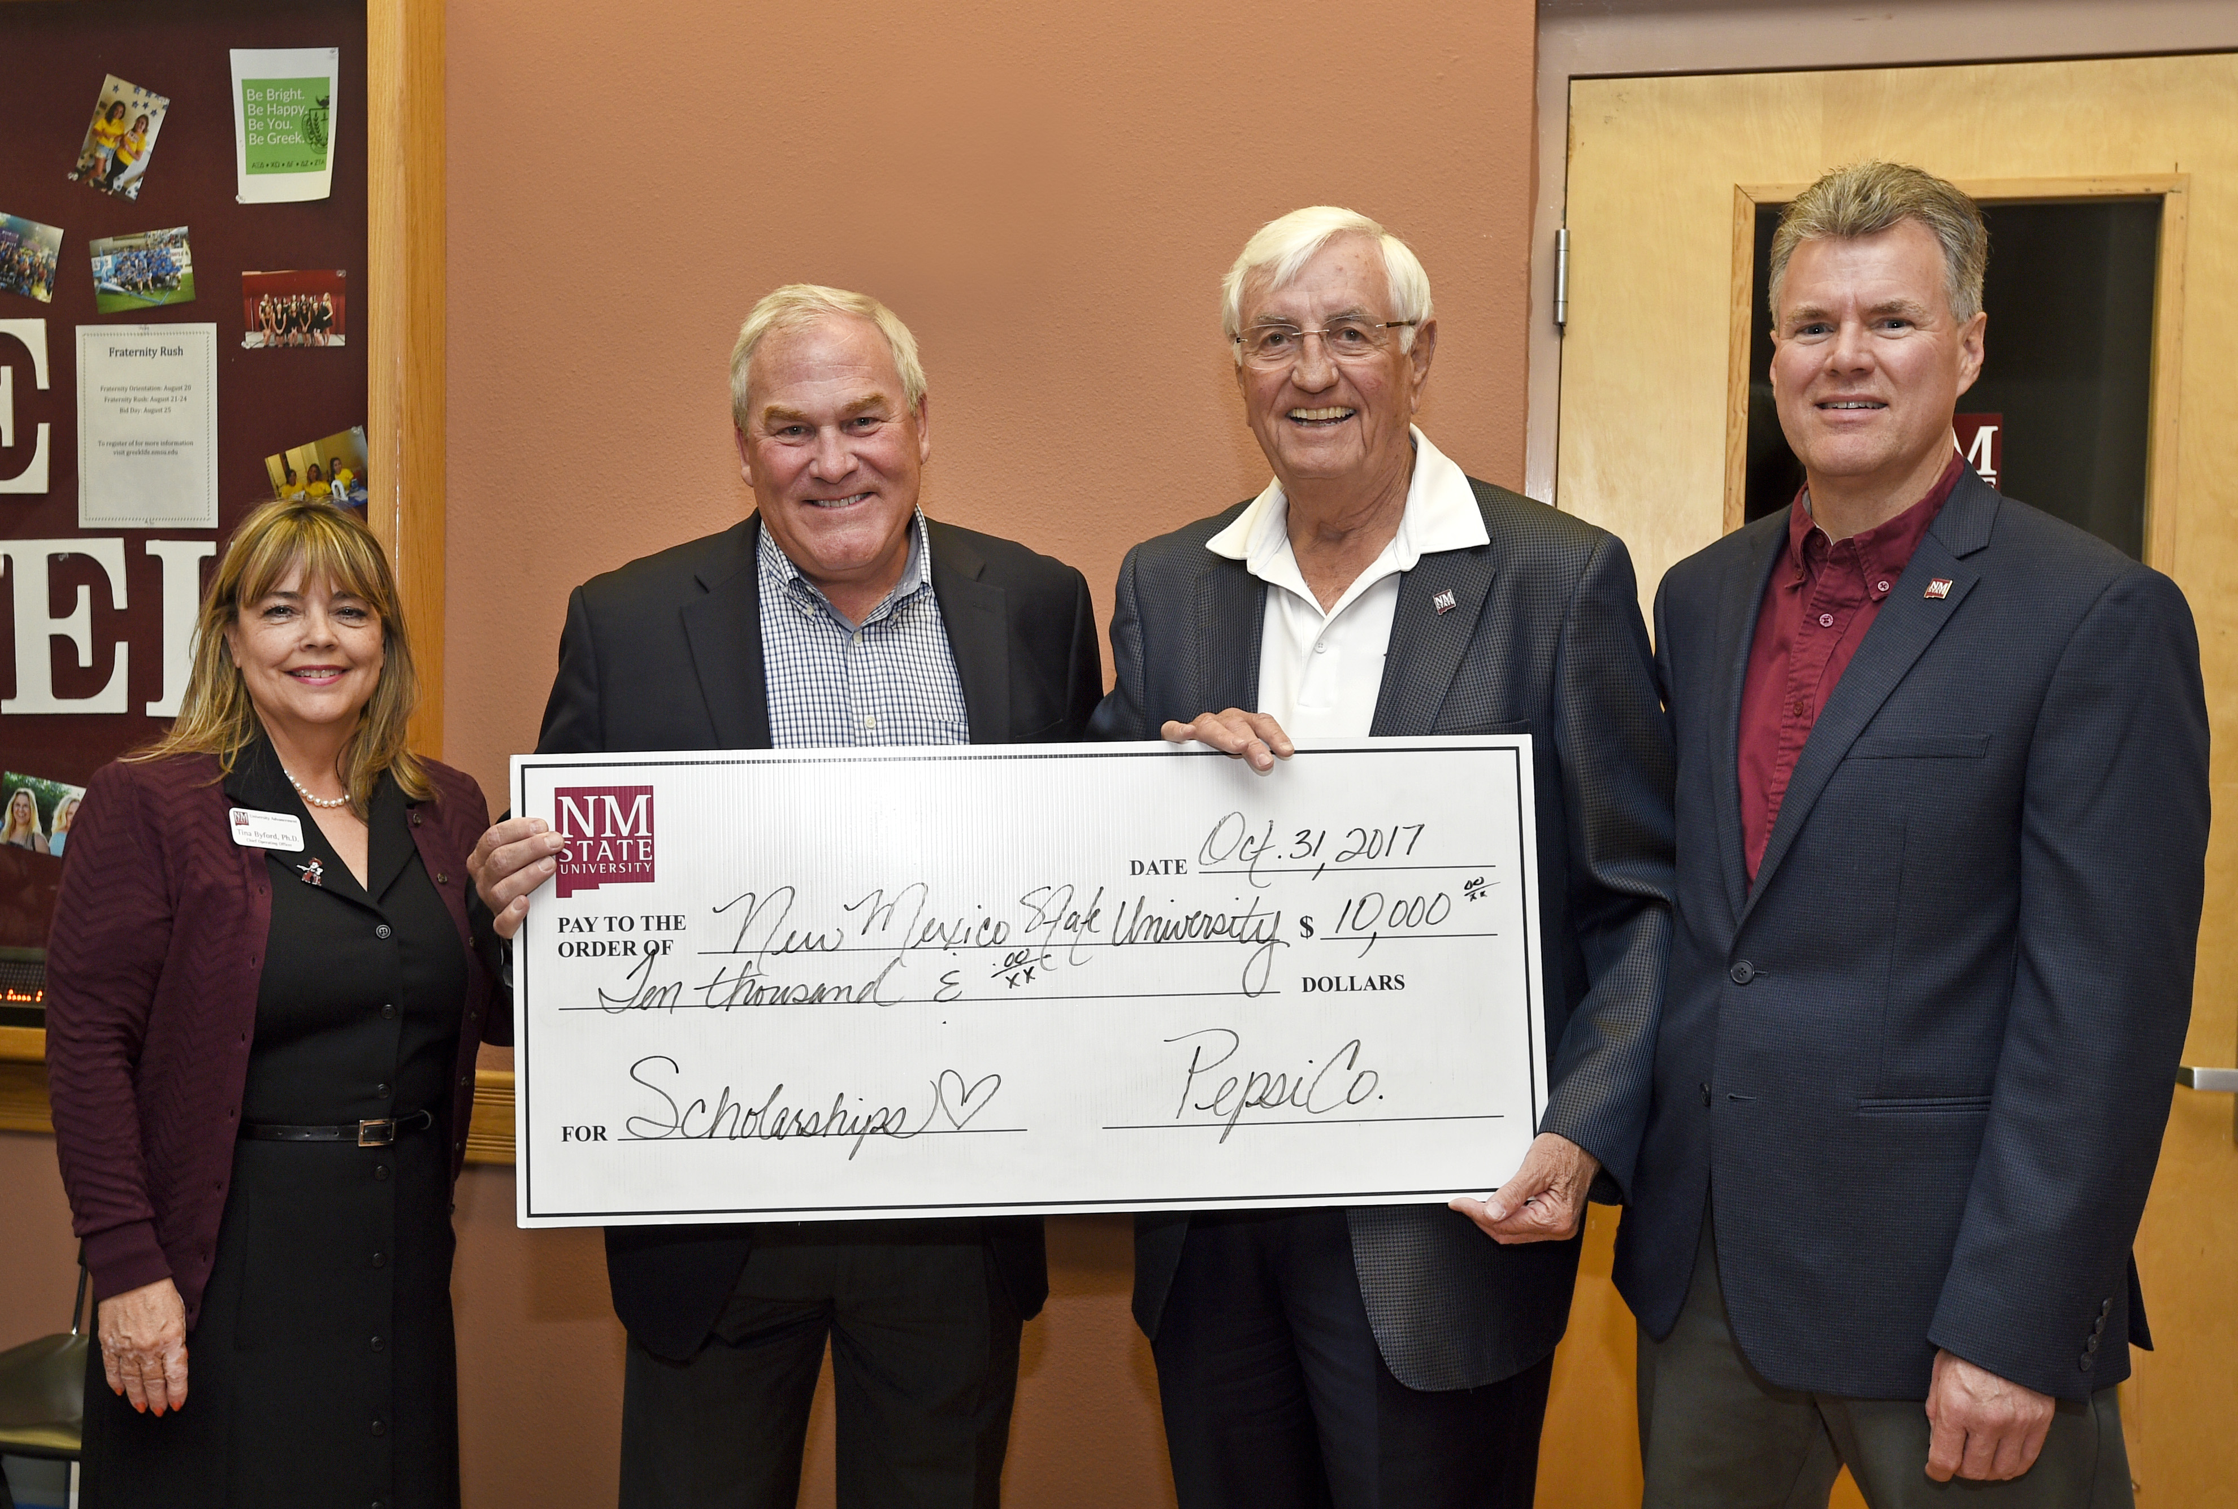
Why does Business College take Money from PEPSI?
https://newscenter.nmsu.edu/Articles/view/12790/pepsico-funding-new-scholarships-for-nmsu-college-of-business

Slide 20
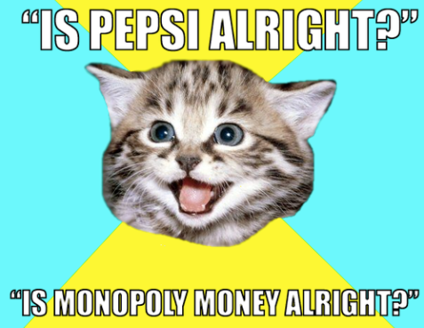

Slide 21
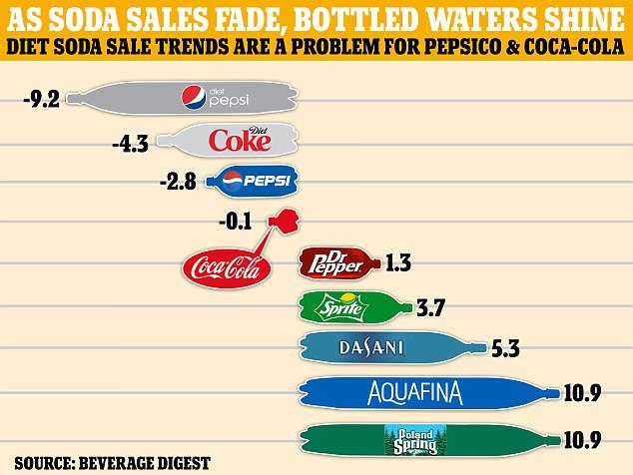
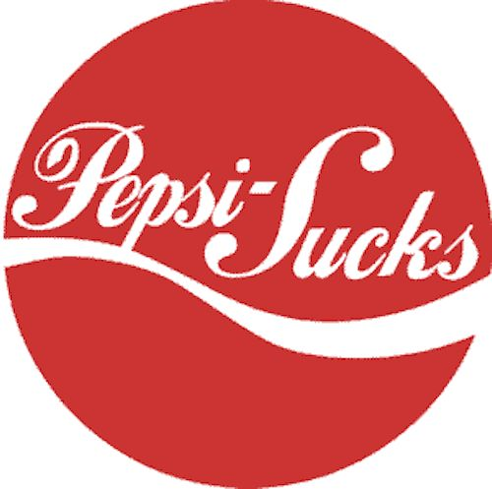
PEPSI HISTORY
https://www.youtube.com/watch?v=T-8mKTAkYa4
THE WAR IS GOOD FOR BOTH PEPSI AND COKE

